Slide 1
Swedish Rental Kart Championship 2023
Practical information

Slide 2
Arrival at Gokartcentralen
Proceed to the counter and tell them your name. GC staff are informed how many practice heats you have reserved and how much you have to pay.
Both lobby and conference rooms are availible for SRKC-drivers and their supporters.
Address: Arntorpsgatan 22, 442 45 Kungälv

Slide 3
Information at the track
The wall, outside of the briefing room and the toilets, will be used like a notice-board with information about your heats, karts, results and other important notes.
You are of course always welcome to contact me (Glenn) or the staff in person if you have any questions.

Slide 4
! Be ready for your heats
We want every driver to be seated in your kart with correct weight when the heat before yours have ended so we can start your heat as quickly as possible. This principle should be used during practice as well.

Slide 5
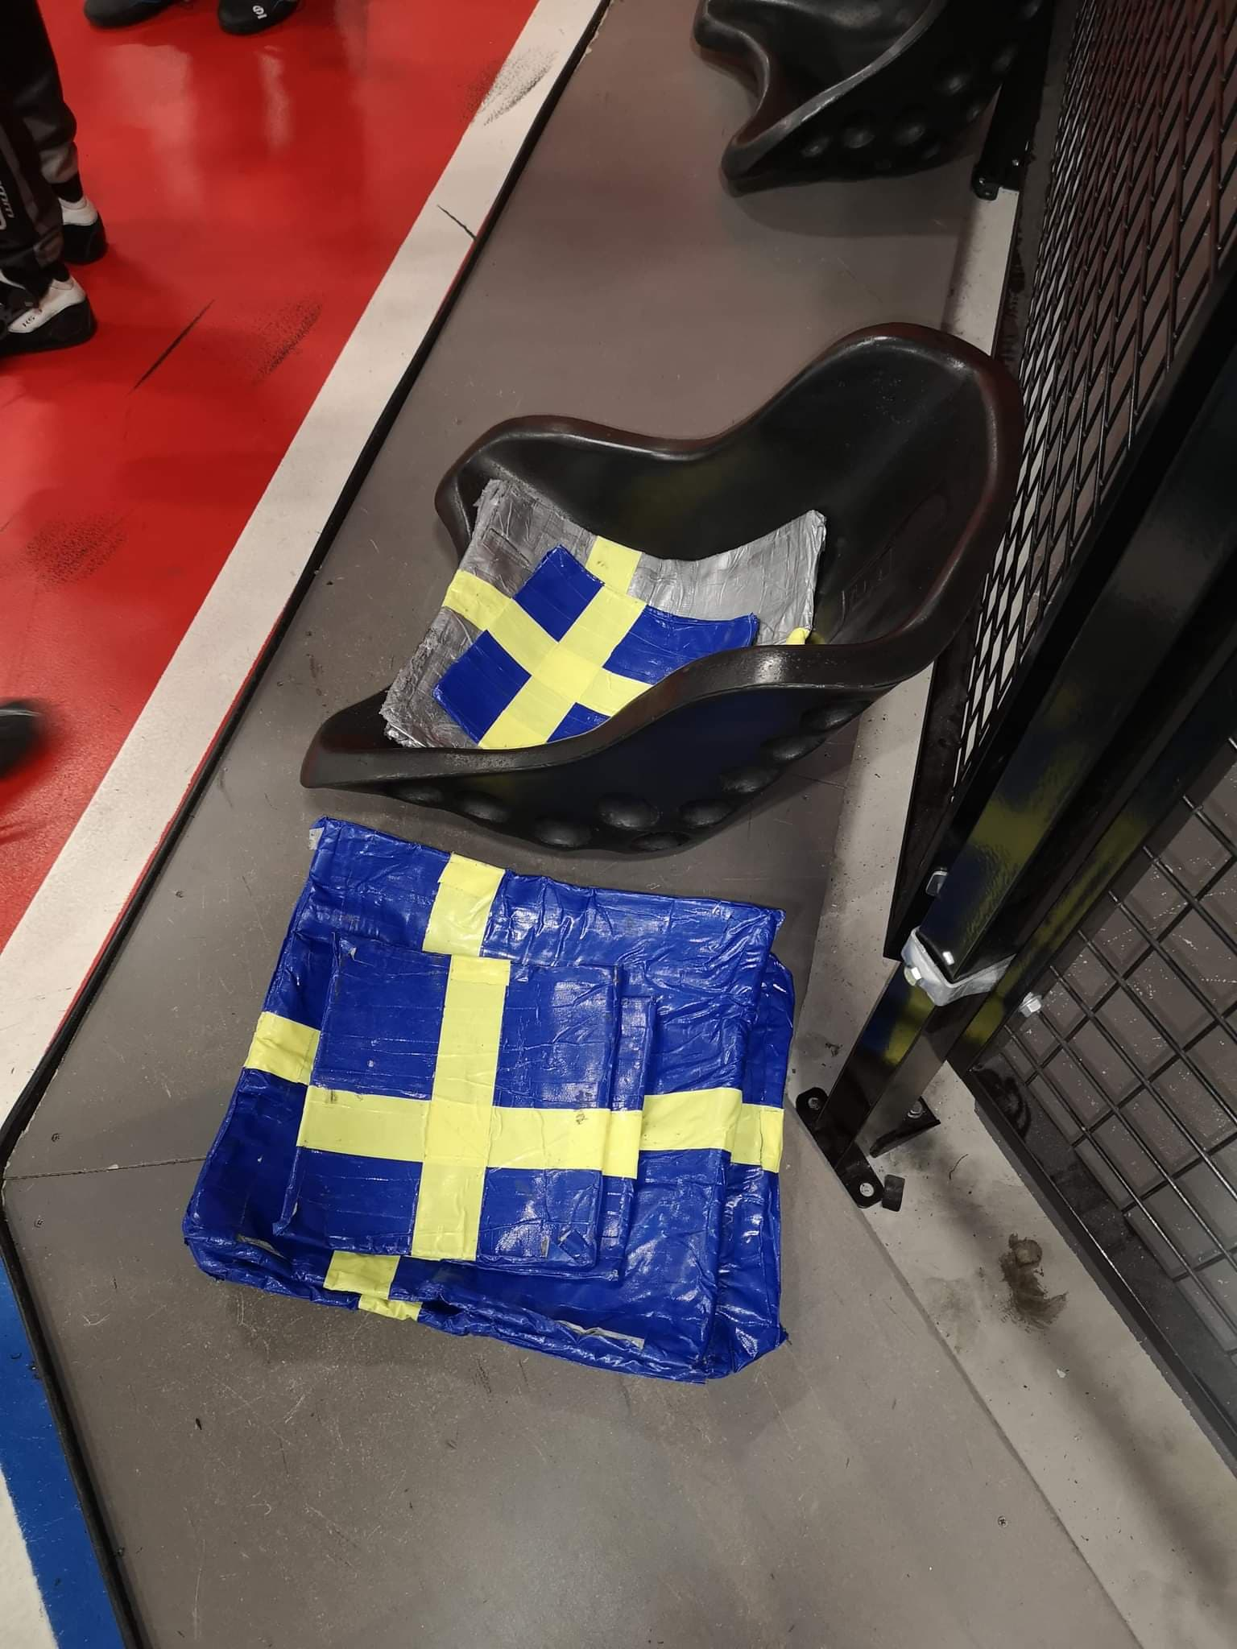
Ballast units
We have 2,5kg and 5kg+ led plates available for you.
Please return these led plates to marked zones in the pit area after your heat.
We will make weight control check with the led plates, you have raceed with, included.
The driver is always responsible for their own total weight.

Slide 6
Summarized race layout
 | Round 1 | Round 2 | Round 3 | Round 4 | Round 5 | Semifinals | Finals
Result based on: | Best lap time | Best lap time | Race position | Race position | Race position | Total lap time | Race position
Laps: | 6 | 6 | Q+12 | Q+12 | Q+12 | 8 | Q+20
Direction: | Reverse | Reverse | Normal | Reverse | Normal | Normal | Reverse
Starting procedure: | - | - | Standing | Rolling | Standing | - | Rolling

Slide 7
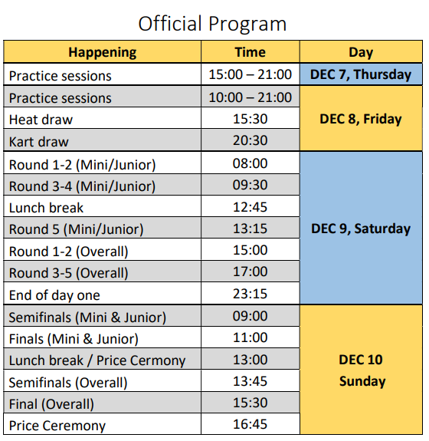
Time schedule

